Slide 1
ESC/ERS 2022 Guidelines for Pulmonary Hypertension
Dr. Aysel ISLAMLI
10. 12. 2022
EGE Hospital
11th National Congress of Azerbaijan Society of Cardiology
Notes:
Today we focus in twenty twenty two PH guidelines

Slide 2
Notes:
Today we focus in twenty twenty two PH guidelines
Greats thanks to ESC and ERS for joint guidelines

Slide 3
Notes:
And updates in the new guidelines - hemdoynamic definition. Clinical classification, and diagnostic algoritm

Slide 4
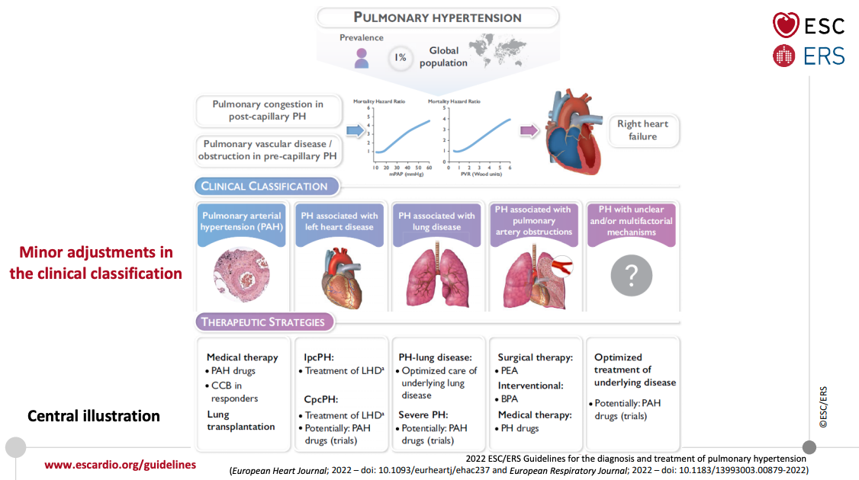
Notes:
This is a central illustrations of new guidelines
First of all I want to emphasize that - (vugulamaq isterim ki) Pulmonary Hypertension is not rare (nadir) condition
PH is very seriosuly condition, with negative prognosis and we know PH touch about 1 percent of
global population and 10 % (ten present) of elderly population/
in this guidelines we saw the new clinical classification – five main groups – we talk about this in next slieds.

Slide 5
Three main methodological approaches were used in these guidelines - four questions were formulated in the PICO format and application of the Grading of Recommendations, Assessment, Development, and Evaluations (GRADE) approach and the Evidence to Decision (EtD) framework
Notes:
We saw new methodological approaches in this guideline – such as 4 PICO questions/ GRADE application / Evidence to Decision framework
For this presentation new features are highlighted in red

Slide 6
Notes:
Chosen parametres – secilmish parametrler
Be offered to guide – rəhbərlik etməsi üçün önərilməli mi PH detection üçün

Slide 7
Notes:
And first of all we defined and must know some hemodynamical parametres
And PH is now defined hemodynamicli by Right Heart Catheterization as a mean PA pressure above 20 mmHg.
For precapillary PH and also for postcapillary PH we intraduced the idea of the wood unites – one of the important characteristic for the precapillary component, threshold was defined more than 2 wood units
Something is new i in this classification such as exercise PH – defined ratio (reysho) mPAP/CO slope beetween rest and exercise above 3 mmHg/l/min

Slide 8
Notes:
Further – daha ileri probablity – olasılık
In this slied we see the same threshold for TRV – so in new guideline kept the inferior level -egual to 2.8 and 2.9-3.4 and above 3.4 were the limits for TRV.
The high levels of TRV raise (artirir) the suspacion of pulmonary hypertension.
In intermediate group we must follow wtih echo and in high probability of PH we need futher intervention – RCC if indicated

Slide 9
The TAPSE/sPAP ratio was higher in SSc patients not referred for RHC than in SSc patients referred for RHC according to the DETECT algorithm step 2 [0.83 (0.35-1.40) mm/mmHg vs 0.74 (0.12-1.09) mm/mmHg, P < 0.05]. Using a cut-off of 0.60 mm/mmHg, 8 (15.7%) SSc patients had a TAPSE/sPAP ratio of ≤0.60 mm/mmHg
Notes:
Suggestive – hatırlatıcı, fikir verici. PH ni hatırlatan. These anatomical structures should be evaluted (bu anatomik strukturlar değerlendirilmelidir)
Additional echocardiographic signs suggestive of PH – and its new in this guideline - ratio TAPSE/sPAP to detect PH
low TAPSE/SPAP index was associated with significantly higher hazard ratio of all-cause mortality
The TAPSE/SPAP index, reflecting RV systolic function

Slide 10
Notes:
SUSPECTED – ŞUBHELİ
There is a lot of nice picture in this document
And this picture shown guidance for right heart imaging for general cardiologist and imagining specialist to describe and evaluate RV.

Slide 11
Notes:
rapid exhaustion (rapid ekzasçın) – hızlı tükənmə/ bending forward – öne eğilme/ nausea (naja) – mide bulantısı/ weight gain – kilo almaq/ hoarseness (horsnes) – ses kısıklığı/ RV backward failure – geriyedönük
Çatışmazlıq əlamətləri), dizziness – baş dönməsi.
We always start from phisical and clinical examination, signs and symptoms,
This is also a new additiona to this guideline with tables with sighs and symptoms – the early symptoms and late symptoms,
And its is very important to detect PH suspicion patient – because PH has this symptoms and signs

Slide 12
Notes:
Seeking for a common cause and warning sighs– ortaq səbəb aramaq suspected -şübheli warning sings – uyarici işaretler
And this is also reflected to new guidelines – to diagnostic algoritm, these algoritm not only for patient suspicion PH, also for unexplained dyspnoea patients
In step one – general practitioner (praktisioner) shloud be seek (axtarmaq) causes for respiratuary and cardiac disorders.
The second important part is here the fast track refferal at any time in a case of warning sings -to PH centre.

Slide 13
Notes:
The second step in unexplained dyspnea and suspected PH detection – the futher lung and heart asessments
When we exclude with echocardiography disease of PH – we must movie patient cross referal to lung assesment to our lung specialist - pulmonologist

Slide 14
Notes:
If patient PH probability in ntermediate/ high risk group, you can recomended the PH expert centre for this patient, for comrehensive assesment

Slide 15
Notes:
Changes in clinical classification very briefly (qisaca) – important changes in PAH non responders and acute responders in idiopathic PAH group
And in this group we see heritable, assosieted with drugs and toxins, connective tissue disease. HIV infections and other

Slide 16
Notes:
gROUP 2 – is assosieted with heart failure – wtih preserved and reduced ejection fraction
Group 3 – assosieted with lung disease – obstructive lung disease . Hipoxemia and hipoventilation syndroms
Sleep dısordered breathıng ıs removed from the classıfıcatıon - Uykuda düzensiz solunum sınıflandırmadan çıkarıldı

Slide 17
Notes:
Group 4 - is assosieted with pulmonary artery obstructions – choric trombo embolic PH and other obstruction disease
Group 5 – unclear and multifactorial disease such as – hematological disorders, sistemic disorders, metabolic disorders , chronic renal failure with and without hemodialysis and ecs

Slide 18
Notes:
Maintain – sürdürmek, bakmak (look) according – binaen, görə.

Slide 19
Notes:
An annual (anyuıl) evalution – yıllık değerlendirme. An annual evalution of the risk of having PAH – PAH riskine ilişkin yıllık değerlendirme/ remain – qalmaq, remain unexplained – açıqlanmamış qalırsa
In SS patinet the new guideline keep high class recomendation – for that - its neseccery to follow up with echo? If the breathlessness remain unexplained following non invasive assesment RHC is recomended to exclude PAH patient

Slide 20
Notes:
CTD – connective tissue disease
BNP NT – pro BNP , policies to evalute PAH in SS patients CT CMR will be considered.

Slide 21
Notes:
RHC is recomended to confirm the diagnosis of PH and to support treatment dexisions.
And it is recomended RHC to perform in experienced centers

Slide 22
Notes:
And we also recomended that a complete set of hemodynamics parametres and calculations- must presented and reflected in our catheterization reports/
This table show that – what should be written in the hemodynamic report by interventional cardiologist

Slide 23
Notes:
I would like to briefly talk about PH risk assessment and therapy.

Slide 24
Notes:
And İm going to try to explain this important algoritm, in this guideline.

Slide 25
Notes:
First, im going to focus idiopatic, heritable, drug assosieted and connecting tissue disease assosieted PAH, so here we have high level of evedence.
In fact - the diagnosis of PAH will be confirm (conförm) at PH centre,
İnitial RCC for the diaqnosis group 1 PAH – is absolutely mondatory (kesinlikle zorunlu). for diaqnosis, but also for the first step for treatment of patients İdiopathic, herritable, drug assosieted PH which responded to vazoreactivity testing

Slide 26
Notes:
Im just show you here - that the vazoreactivity testing should be performing in patient with presumed (presyumd- varsayilan) idiopatic, heritable and drug assosieted PH. In connection tissue disease we dont do vazorectivity testing, because there is no evidence of consensus (kensenses- uzlashma) of the results of this. Patient are reffer to the PH centre and in there doing for this patient RCC, there will be testing acutly vazoreactivity testing with eigher drugs – inhale (inheyld) nittic oxide or ilioprost, or with intravenously drug epoprostenol. And the patient, in which there is drop mPAP by more than 10 mmHg from baseline and drop mPAP below than 40 mmHg with increased cardiac output. If the patient meets t(qarshilamaq) this criteria – this patient is a candidate (kendideyt) for Ca cannal blocker therapy and titration for this therapy.
The patient reassesed after 3 or 6 month from Ca canal blocker therapy. If the funcsional class of patient, NT proBNP nad BNP levels is normal in resting hemodynamic, we continue therapy and assesment this patient after 6-12 month. But if the level BNP, NT pro BNP is high we accept this patient such as chronic non responder patient and looked at other PAH spesific therapy algoritms.

Slide 27
Notes:
Then, when the patient who are not chronically responsive they will go throughout very longly, clearly and evidence based algoritm.

Slide 28
Notes:
Firts of all there are some general measures (onlemler) throughout of the disease (hastaligin seyri boyunca genel onlemler) there is just some new comments such as – supervised exercise training under medical therapy, psychososial support (saykosoşil), immunization, iron corrections in the presence iron deficiency

Slide 29
Notes:
İt is important to say we no longer recomended anticoagulation for all patients. Non vasoresponder patients we will be evaluate cardiopulmonary comorbidities.

Slide 30
Notes:
In patient without comorbities, we have major discoveries in the assesment of risk, risk of death at one year. It shloud be evluate risk stratification at baseline , and it shloud be evalute risk stratification at follow- up.
At baseline we use three strata approach, which is published in 2015. And we will identify patient with high risk of mortality at one year, more than twenty percent (20%) risk , or low or intermadiate risk – less than 5, 5 to 10, to %20 risk.

Slide 31
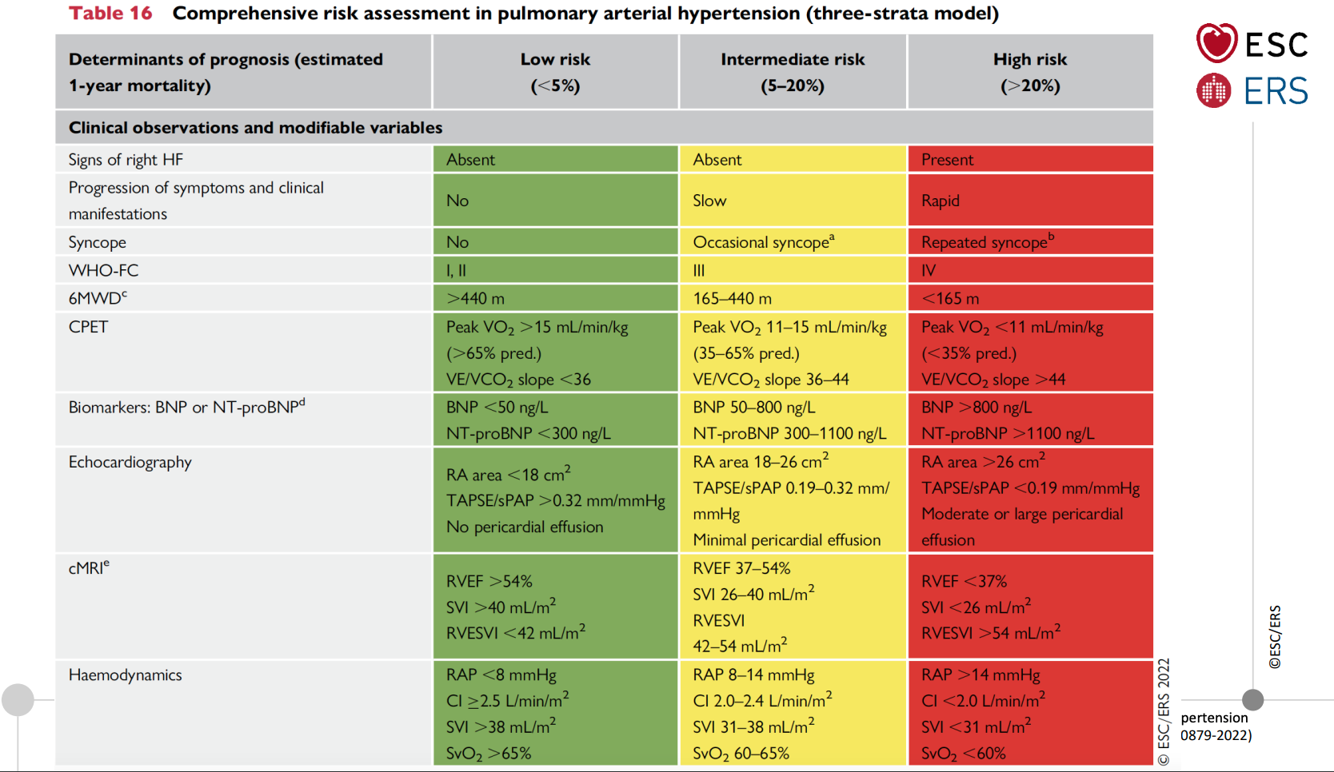
Notes:
You see comprenhensive risk assesment in PAH on this table, for the 3 strata model,
There are sigh of right heart failure, syncope, functional class of patient, six minute walk distance, CPET, BNP levels, imaging …- is very important for the risk asssesment and on treatment desicion.

Slide 32
Notes:
What is really new in this risk asssesment model ? – new cut offs BNP and pro BNP levels included new parametres of MRI and included stroke volume index in the invasive hemodynamic parametres.

Slide 33
Notes:
We see the pathophysiology and current therapetic targets of PAH – And we know, there are 14 drugs approved in PAH in a world.
There are three pathway – endotelin pathway, nitric oxcide pathway and soluble guanylyte cyclase cyclic GMP pathway, and the prostocyclin pathway

Slide 34
Notes:
Tratment decision are planning on a patient risk group – if you have high, low and intermediate group - desicion will be different beetween this groups.

Slide 35
Notes:
I show you the recomendation for the treatment for patients non vasoreactive patients with idiopathic, heritable or drug assosiated PAH.
Who present without cardiopulmonary comorbities with patient high risk of death, initial combination theraphy with a PDE5 inhibitors and endotelin receptor antagonists and iv/ sc prostacyclin analougs
should be considered 2AC recomendation.

Slide 36
Notes:
From slied

Slide 37
Notes:
We must call visits our patient every 3-6 month to reasses new risk and assest the therapy management of this patient

Slide 38
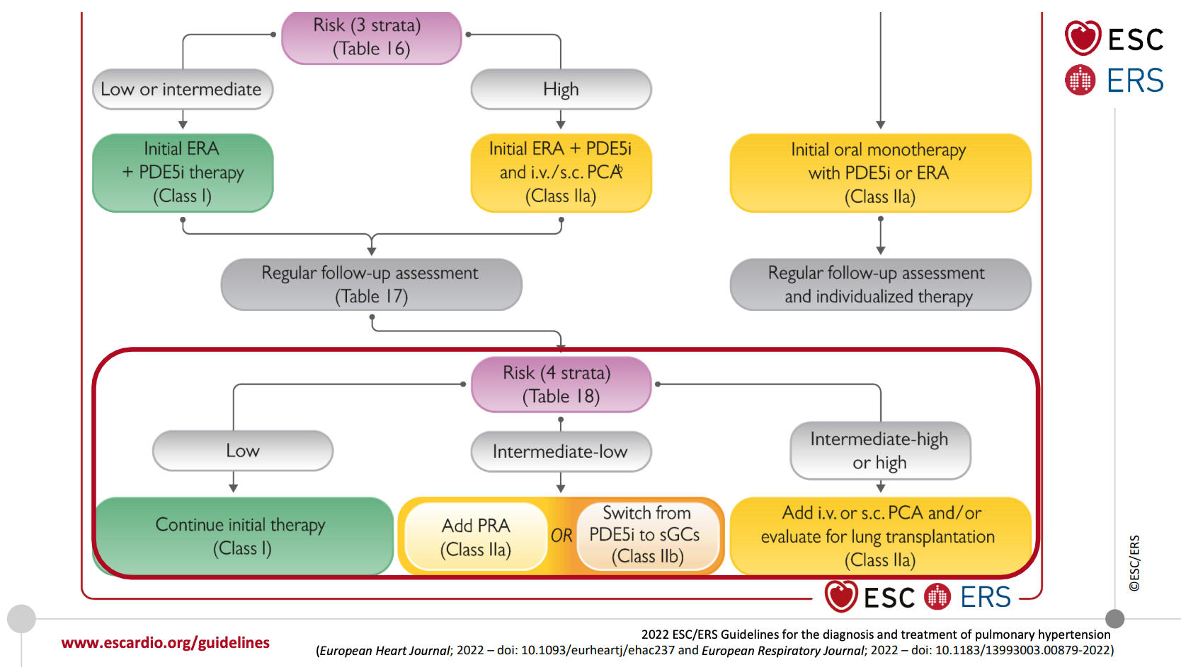
Notes:
From slieds

Slide 39
Notes:
For this patient we have spesific recomendations, in patient intermediate low risk of death, who receiving oral ERA/PDE5 inhibitors therapy, addition of selexipag shloud be considered in patient with intermediate high risk or high risk who receiving ERA/PDE5 inhibitor double oral combination theraphy, addition of iv or subcutaneusly prostacyclin analougs.
In intermediate low risk ….switching from PDE 5I to riociguat may be considered.

Slide 40
Notes:
Final comment before closing – the patient is focusing on with cardiopulmonary comorbities, these patient have less evidence in the literature.
bUT WE GIVE THIS PATIENT INITIAL MONOTHERAPY AND REGULAR FOLLW UP ASSESMENT AND INDIVIDUAL THERAPY

Slide 41
Notes:
bUT WE GIVE THIS PATIENT INITIAL MONOTHERAPY AND REGULAR FOLLW UP ASSESMENT AND INDIVIDUAL THERAPY

Slide 42
Notes:
And conclusion and take home messages (mesejes) a new definition PVR to identify the precense of pre capillary component,
Exercise pulmonaru hypertension is now defined,
No changed in a threshold of tricuspid (trakuspid) regurgitation velocity,
The change in classification, intraduce responce to acute vasoreactivity testing and responders under umbrella of idiopathic PAH
And we use the term assosieted applies to group 1 – to 4

Slide 43
Notes:
We must use this treatment algoritm for every PAH patient
I am going close my presentation
Many thanks all of you for kind attention

Slide 44
Thank you !

Slide 45
Pulmonary Hypertension (PH) is a disease with high mortality

